Slide 1
Visual Builder Redwood POC’s for Fusion SaaS
© 2025

Slide 2
Summary of Redwood POC’s as of July 2025
Module | Title
SCM | Sales Order. Query page with hash keys | 1
SCM | Sales Order. Query page that run some process | 2
SCM | Transfer Orders. Query page to update some field. | 3
Procurement | Purchase Requisitions. Query Page | 4
Receivables | Invoices. Query page to update Flexfields | 5
Procurement | Suppliers. Basic creation page | 6
SCM | Work orders. | 7
SCM | Visual Builder Redwood Custom pages to scan a EAN13 barcode with mobile or PWA device. | 8
Code and documents provided in : https://github.com/juanjesusmontero/oracle_redwood_cookbook

Slide 3
Redwood POC’s as of July 2025 Code and documents
 | Module | Title | Document and code
 | SCM | Sales Order. Query page with hash keys | Redwood_cookbook_2026_SCM_SALES_ORDERS_HASH.pdf OIC VB-Code: XX_DEMO_SCM_SALES_OR-1.0.zip OIC Integration: XX_GET_SO_HASH_LINE_01.00.0001.iar
 | SCM | Sales Order. Query page that run some process | Oracle Visual Builder Redwood Cookbook 2026_chapter_27.pdf OIC VB-Code: blog_01_part3_fra_demo-redwood-01_19323_1-1.0.zip
 | SCM | Transfer Orders. Query page to update some field | VB_REDWOOD_COOKBOOK_2026_TRANSFER_ORDERS.pdf OIC VB-Code: XX_DEMO_TRANSFER_ORDERS-1.0.3.zip
 | Procurement | Purchase Requisitions. Query Page | VB_REDWOOD_COOKBOOK_2026_scm_po_req_NEW_PAGE.pdf OIC VB-Code: XX_PO_REQ_DEMO_QUERY-1.0.7.zip
 | Receivables | Invoices. Query page to update Flexfields | Not provided.
 | Procurement | Suppliers. Basic creation page | Doc. Provided in book Oracle Visual Builder Redwood Cookbook 2025 Chapter 23. OIC VB-Code: 23_SAAS_SUPPLIERS_103-1.0.zip
 | SCM | Work orders | Redwood_cookbook_2026_SCM_WORK_ORDERS_QUERY_DFF.pdf OIC VB-Code: XX_OIC_VB_DEMO_WORK_ORDERS-1.0.1.zip XX_EXTENSION_WORKPACE_DEMO_WORK_ORDERS_v4.zip
 | SCM | VB Redwood pages to scan a EAN13 barcode with mobile or PWA device. | Redwood_CookBook 2026 SCM ITEM SCANNER Part II.pdf Extension VB code: Redwood_CookBook 2026_workspace_dev4_scan_v01.zip

Slide 4
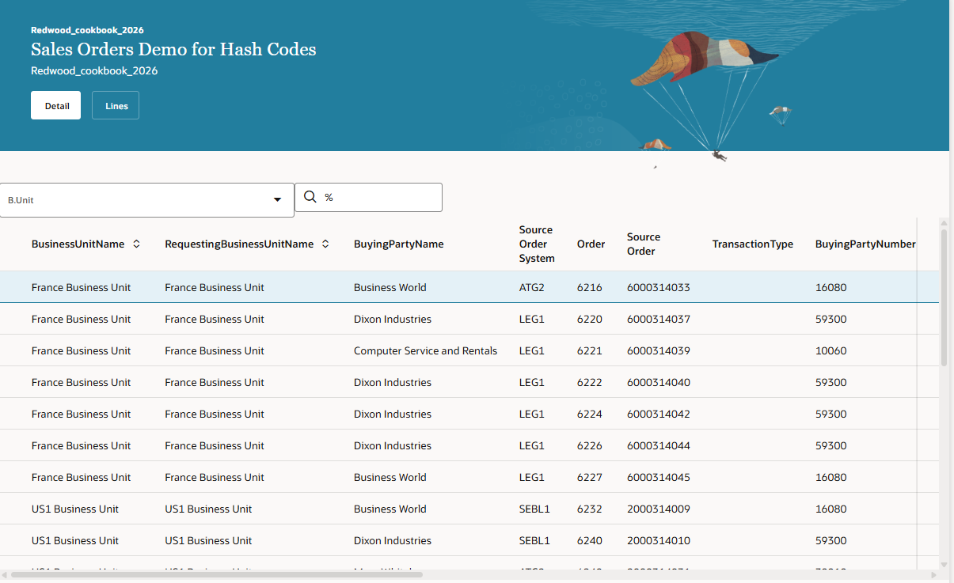
SCM. Sales Order. (1)
First level. Sales Order headers.
Basic filter for Business Unit/Order

Slide 5
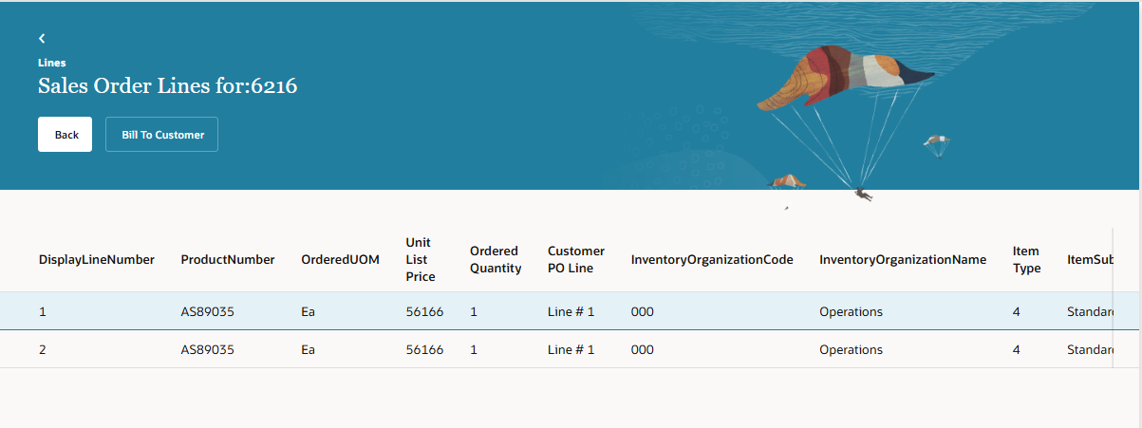
SCM. Sales Order. (1)
Second level. Sales Order Lines.

Slide 6
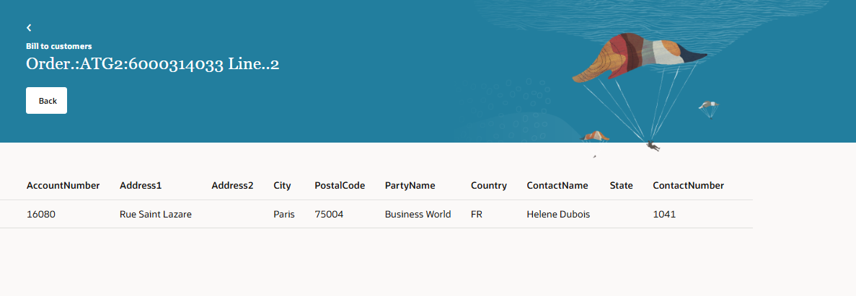
SCM. Sales Order. (1)
Third level. Bill to data for a sales order line.

Slide 7
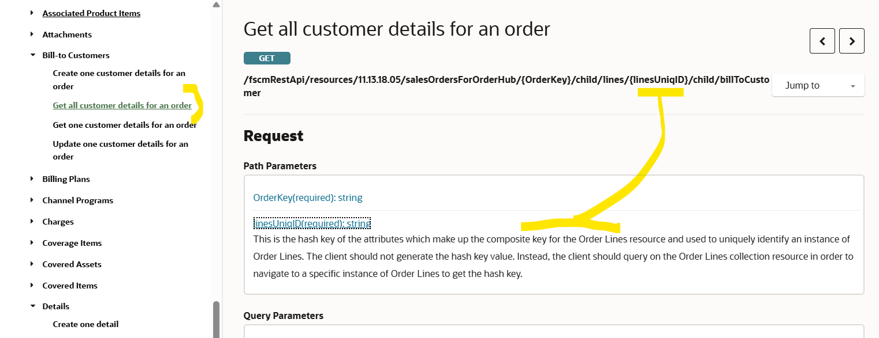
SCM. Sales Order. (1)
Hash codes basics.

Slide 8
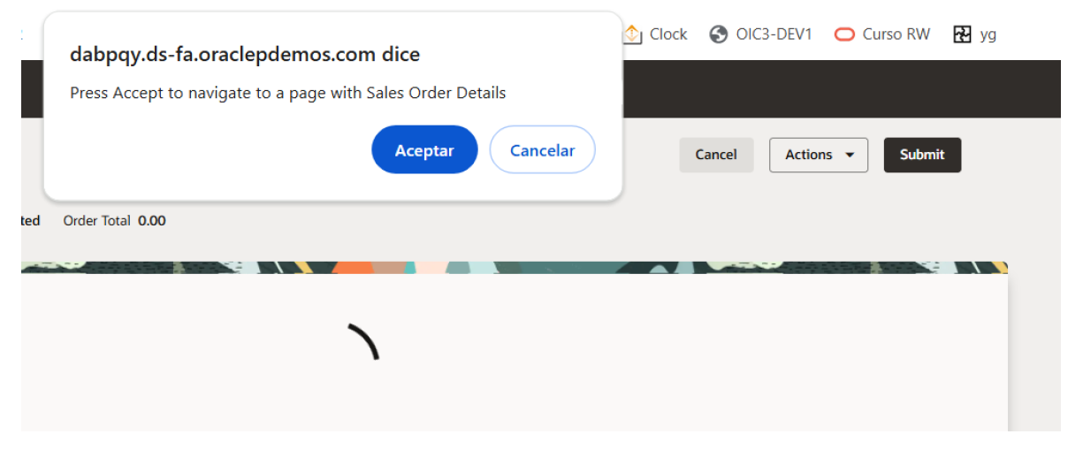
SCM. Sales Order. (2)
Summary: starting navigation from Redwodd Sales Orders page we will access a new VB page extension master detail, able to run any REST API process.
Here we show how to access the new page after opening Sales Order page.

Slide 9
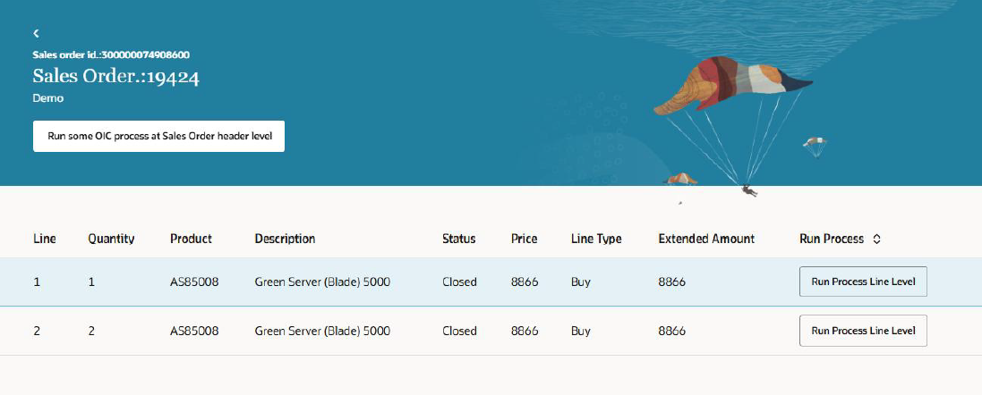
SCM. Sales Order. (2)
New page with process at header level or a line level could be accomplished.

Slide 10
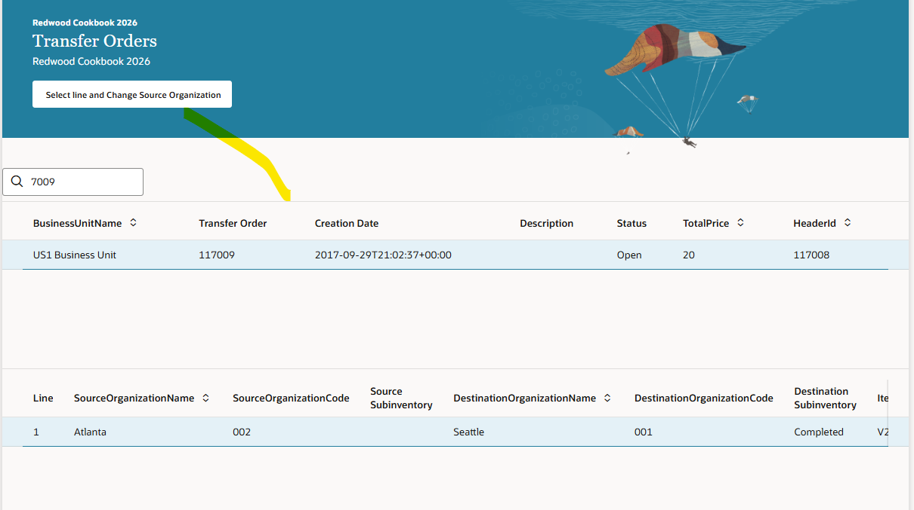
SCM. Transfer Order. (3)
Master-detail query in transfer orders to allow modify some data, clicking the button

Slide 11
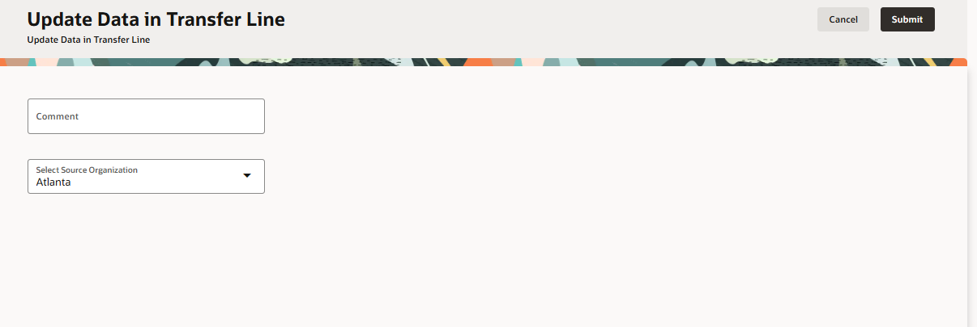
SCM. Transfer Order. (3)
Here it could be posible to update some data.

Slide 12
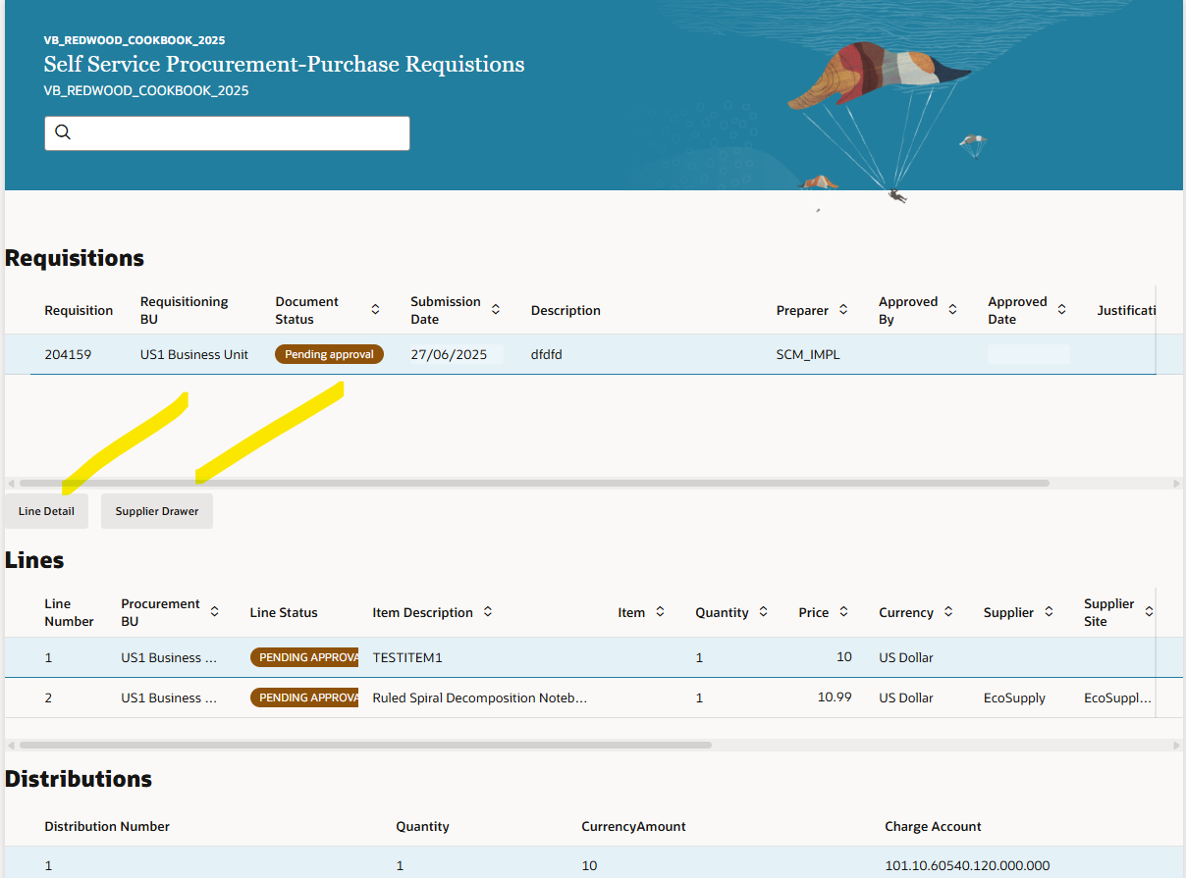
Procurement. Purchase Requisitions. (4)
Only query purchase requisitions
Including detail for line, using first button.
Including detail for supplier in a
Drawer, using second button

Slide 13
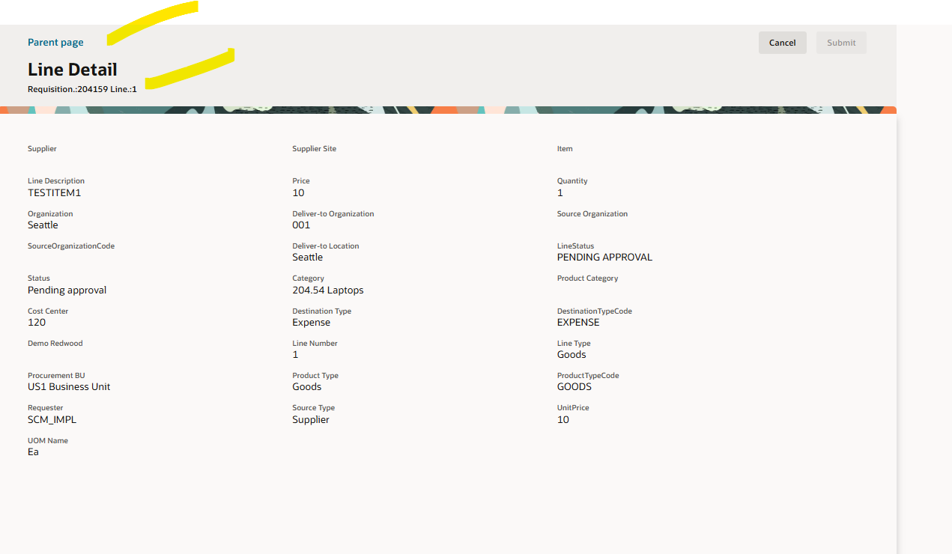
Procurement. Purchase Requisitions. (4)
Line requisition detail

Slide 14
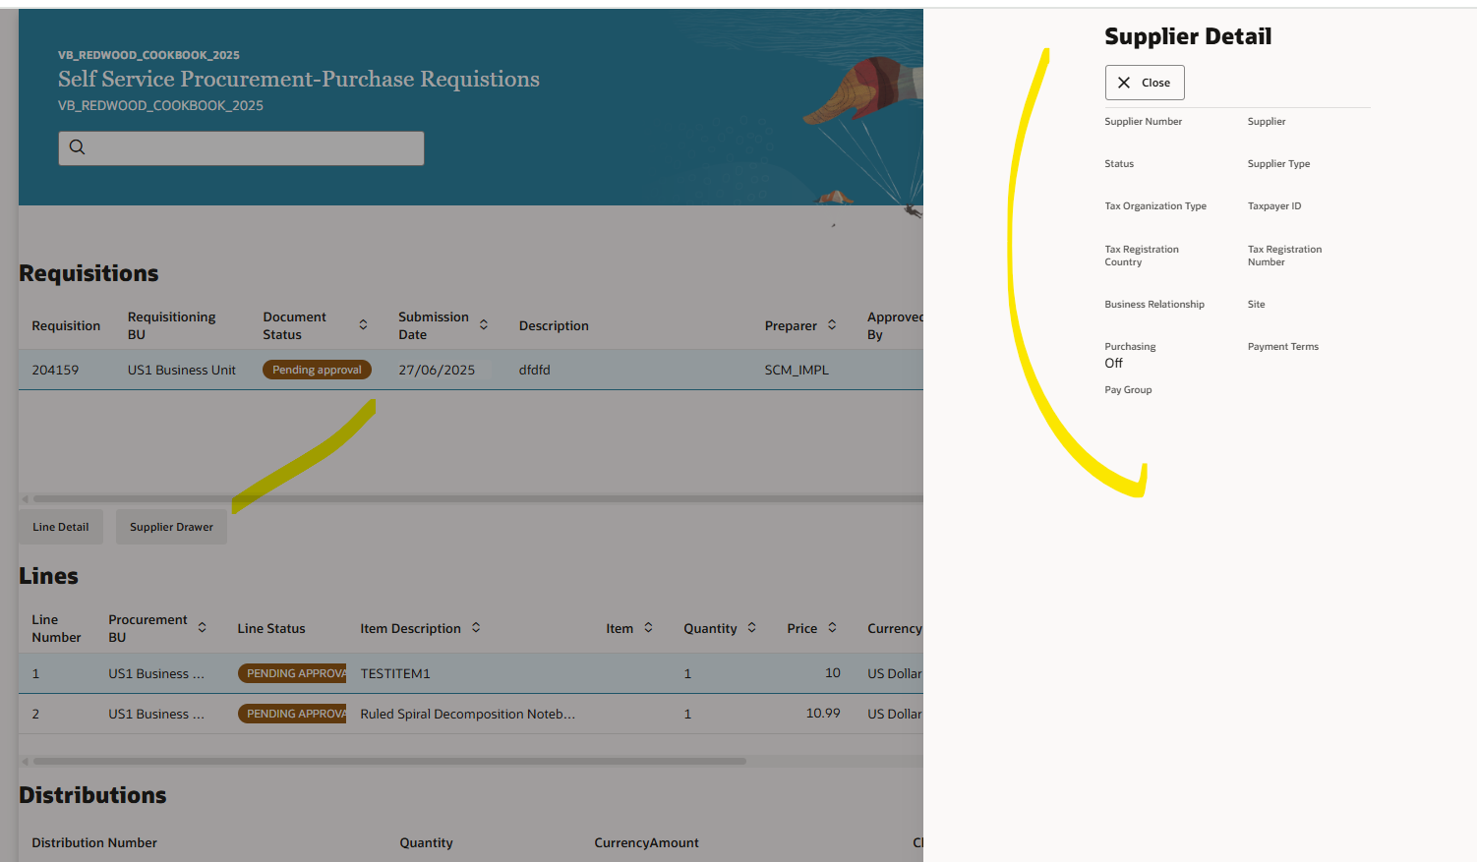
Procurement. Purchase Requisitions. (4)
Supplier detail in Drawer Popup

Slide 15
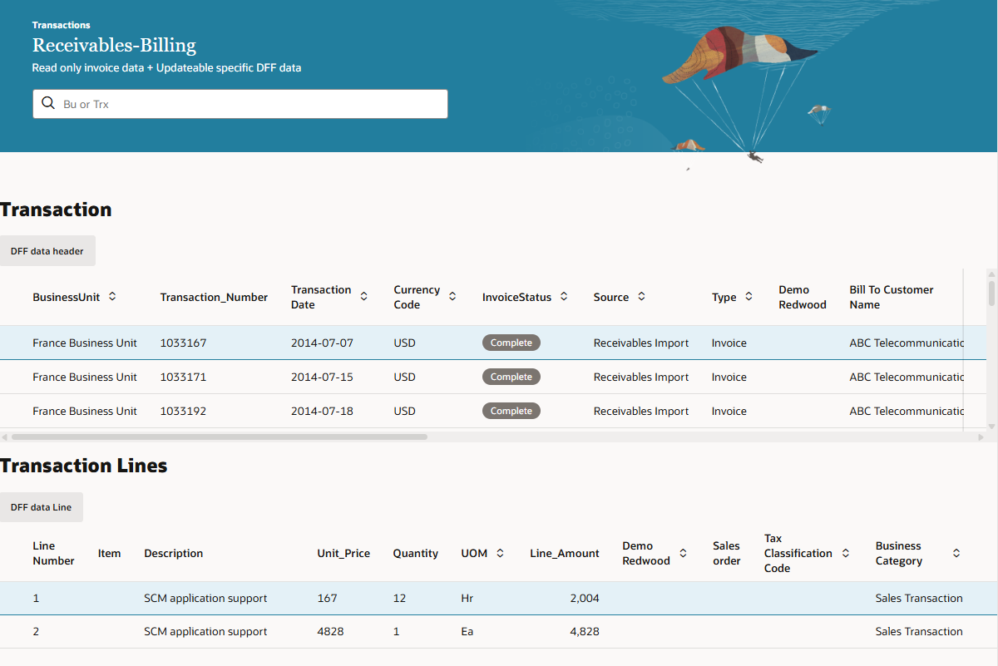
Receivables. Invoices. (5)
Here we allow DFF update in receivables transactions, in headers

Slide 16
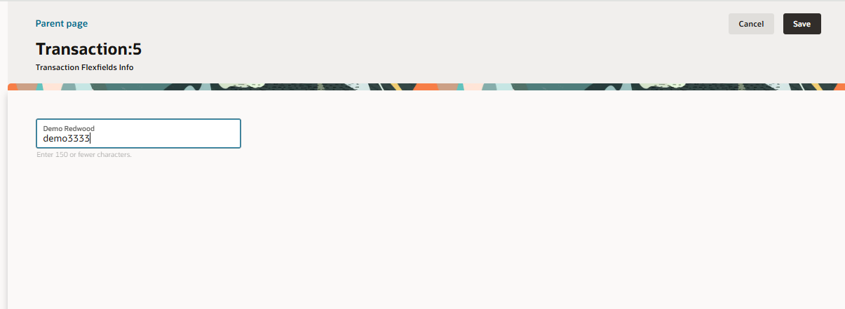
Receivables. Invoices. (5)
Here the user could update the DFF fields as per requirements

Slide 17
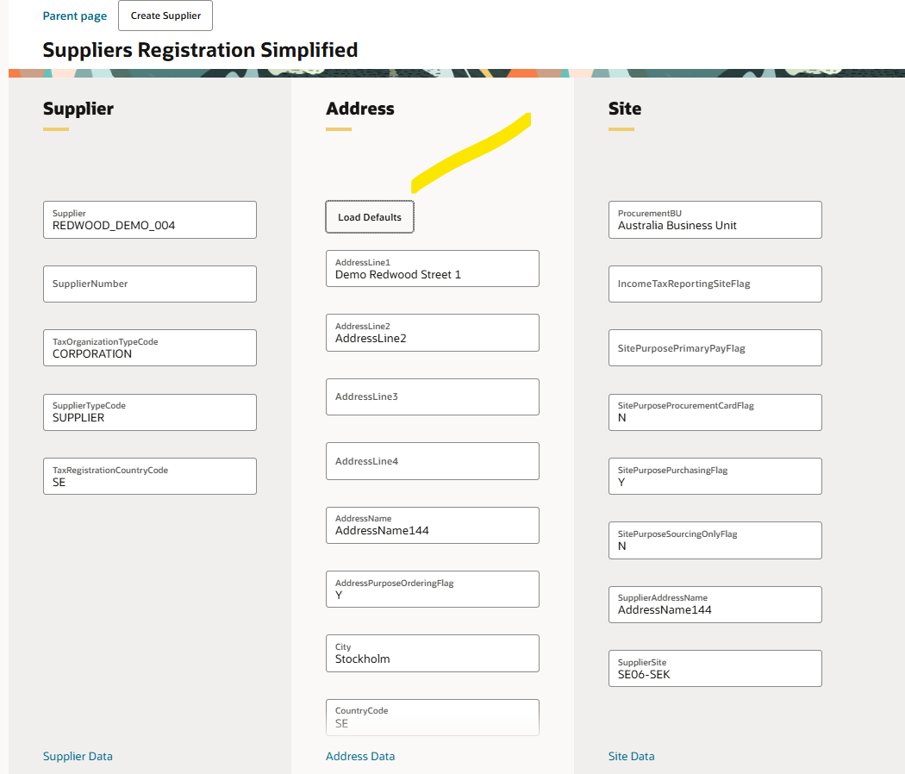
Procurement. Suppliers. (6)
Simplified page to create suppliers
with basic, minimum data.
Goal speed up the creation of suppliers with mínimum data.
Just to show it is feasible to create suppliers using standard REST API.

Slide 18
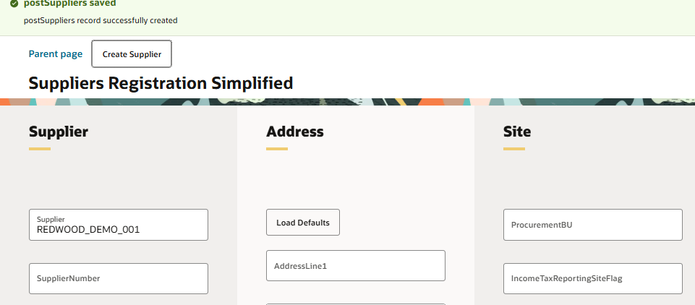
Procurement. Suppliers. (6)
Supplier created.

Slide 19
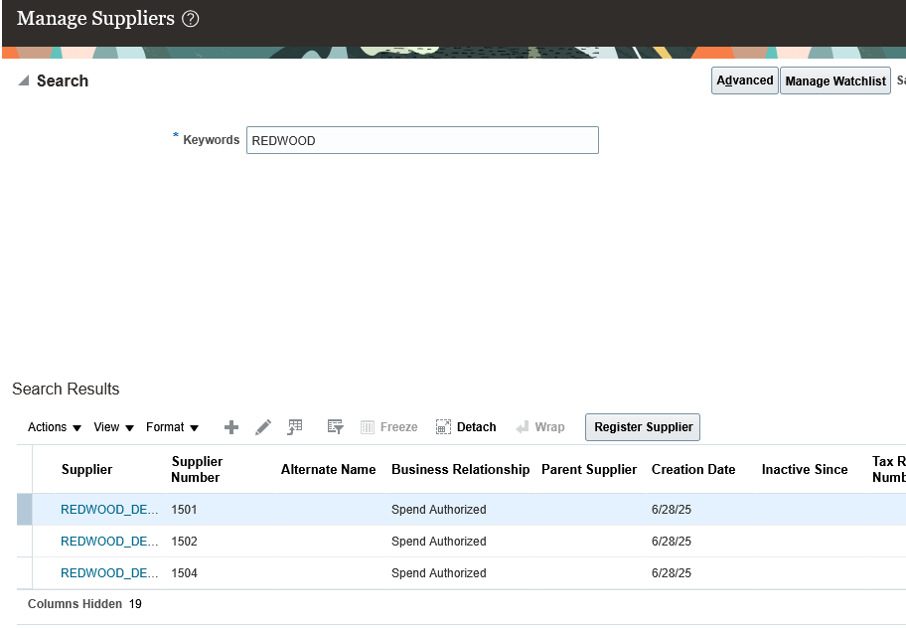
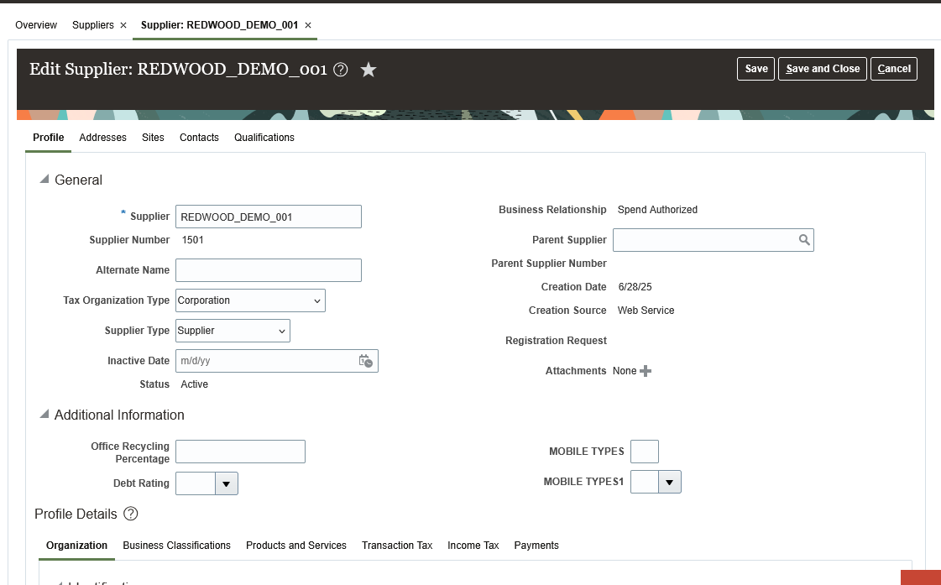
Procurement. Suppliers. (6)
Supplier created.

Slide 20
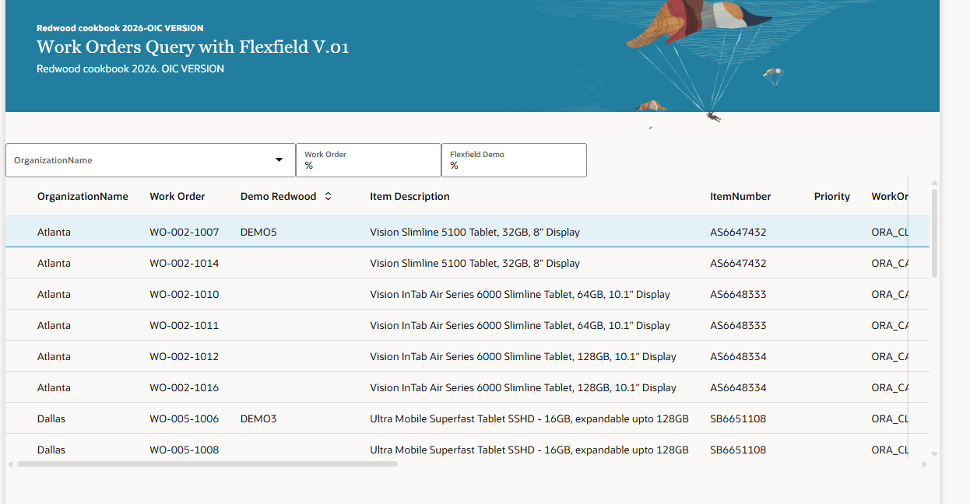
SCM. Work orders. (7)
We have built a page to query Work Orders using flexfield, using both OIC-VB and Fusion-VB.
Example of blind query.

Slide 21
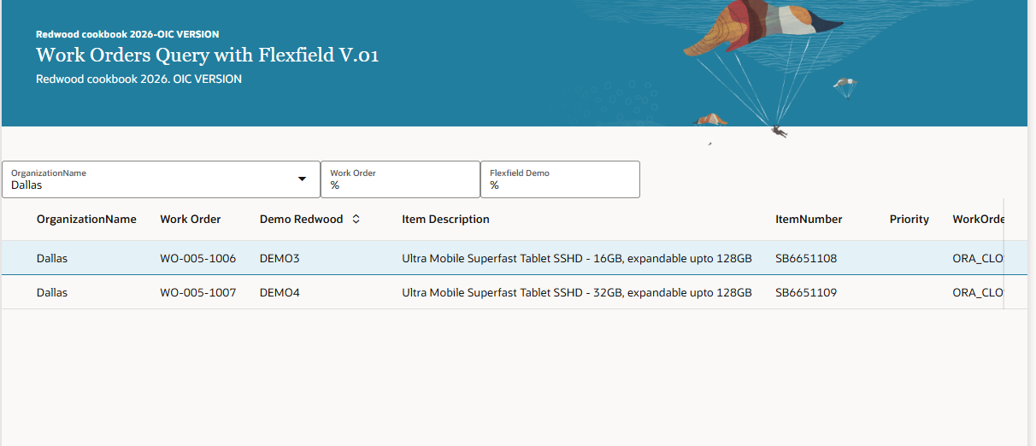
SCM. Work orders. (7)
We have built a page for building a page to query Work Orders using flexfield, using OIC-VB and Fusion-VB.
Example using Business Unit to filter

Slide 22
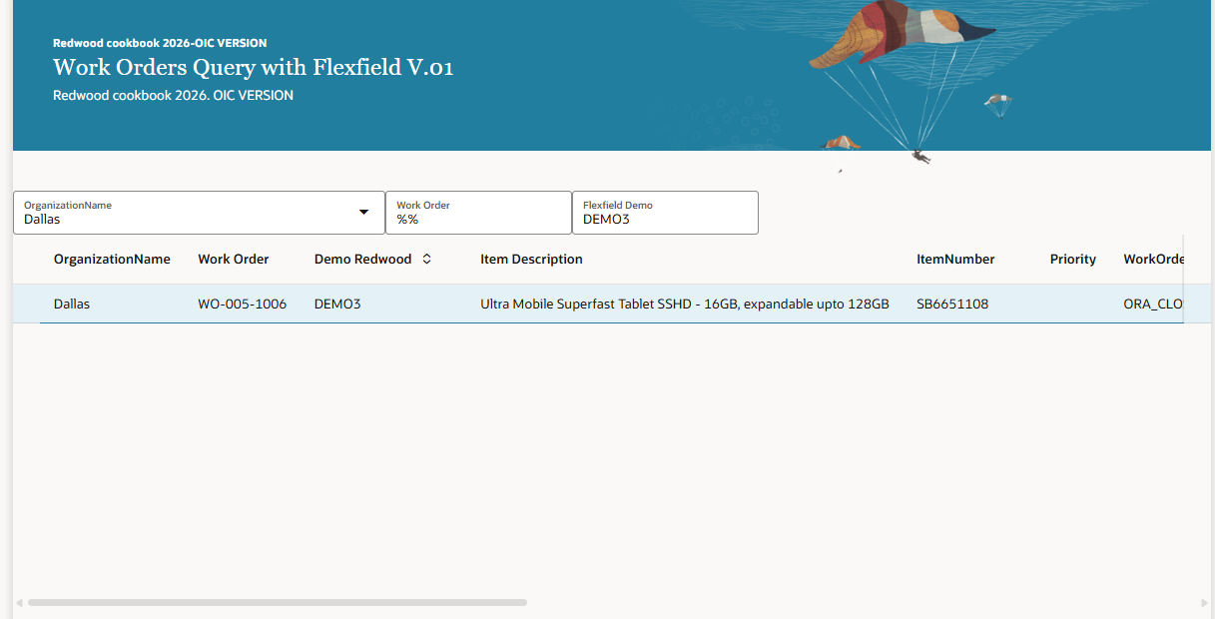
SCM. Work orders. (7)
We have built a page for building a page to query Work Orders using flexfield, using OIC-VB and Fusion-VB.
Example using flexfield to filter.

